Slide 1
Pediatric Neuromotor Wearable
Carl Demolder
Date 8/03/2020

Slide 2
Outline
Project management
Introduction
Project requirements
Project proposal
Block diagram
Schematic
PCB design
Firmware
Schedule
Gantt chart

Slide 3
PROJECT MANAGEMENT

Slide 4
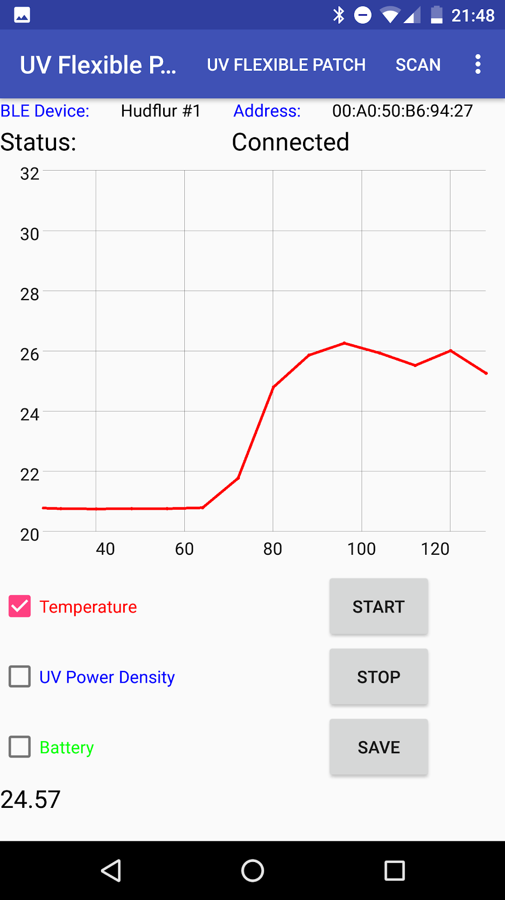

Introduction
Purpose:
Design a wearable with sensors to measure temperature, pressure, strain, and movement. This data will be wirelessly transmitted via BLE to a UI band

Slide 5
Project requirements
Requirements:
Design a flexible circuit to use sensors to wirelessly communicate biophysical data to a UI band
Flexible circuit must include the following functionality:
Wireless charging
Battery management
RTT data logging
Use the nRF52832 MCU/SoC
BLE connectivity and BLE GATT database
Temperature sensing
Motion sensing
Pressure sensing
Strain sensing

Slide 6

Schedule overview
Electronics development
Date range: 8/11–8/23
Estimated hours to produce hardware: 24 hours
Estimated hours to test/debug/qualify hardware: TBD
Firmware development
Date range: 8/23-9/20
Estimated hours to produce firmware: 39 hours
Estimated hours to test/debug/qualify firmware: TBD
Any questions about the scope?
Let me know!

Slide 7
PROJECT PROPOSAL

Slide 8
Block diagram
PHERIPHERAL SENSORS
ANDROID PHONE**
IMU
BLE
BLE TX/RX
TEMPERATURE
RF
MCU/SoC
I²C
ANALOG
POWER
PRESSURE
SENSOR
LIPO BATTERY
POWER
BMS
POWER
STRAIN
SENSOR
WIRELESS
CHARGING COIL
POWER
WIRELESS CHARGING CIRCUITRY

Slide 9
Electronics development: schematic
Schematic generation
nRF52 with supporting circuitry (2 hours)
BLE antenna and impedance matching circuit (2 hours)
Wireless charging (5 hours)
Lithium battery charging (2 hours)
Biosensors: temperature, IMU (4 hours)
Biosensors: pressure, strain (4 hours)
Test points (1 hours)
Project creation (3 hours)
Estimated time: 8 hours
Actual time spent: TBD
REUSING DESIGN FROM PREVIOUS PROJECTS

Slide 10
Electronics development: PCB design
PCB design
Major component layout (4 hours)
BLE antenna and impedance matching circuit (3 hours)
Wireless charging (2 hours)
Lithium battery charging (1 hours)
Overall board construction(1 hour)
Biosensors: temperature, IMU, pressure, strain (3 hours)
Test points (1 hours)
Gerber file generation (2 hours)
BOM generation (2 hours)
Estimated time: 16 hours
Actual time spent: TBD
REUSING LAYOUT FROM PREVIOUS PROJECTS

Slide 11
Firmware development
Firmware
Project and BLE stack (5 hours)
Sensor drivers
I²C driver (4 hours)
Temperature driver (2 hours)
Analog driver (3 hours)
IMU driver (3 hours)
RTT data logging (3 hours)
BLE GATT database and data transfer (31 hours)
REUSING CODE FROM PREVIOUS PROJECTS

Slide 12
SCHEDULE

Slide 13
Schedule Gantt chart
Task | 8/2-8/9 | 8/9-8/16 | 8/16-8/23 | 8/23-8/30 | 8/30-9/6 | 9/6-9/13 | 9/13-9/20
ELECTRONICS DEVELOPMENT
-SCHEMATIC GENERATION
-PCB LAYOUT AND ROUTING
-HARDWARE DEBUGGING
FIRMWARE DEVELOPMENT
-PROJECT STACK ORGANIZATION
-SENSOR DRIVERS
-BLE GATT & BLE DATA TRANSFER
-FIRMWARE DEBUGGING

Slide 14
PATH FORWARD

Slide 15
Path forward (8/02/20 – 8/09/20)
Schematic generation
Wheatstone bridge
PCB layout

Slide 16
APPENDIX

Slide 17
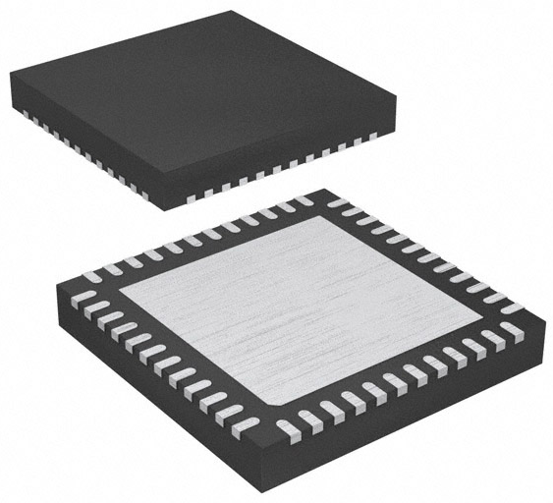
Component selection: MCU/BLE
MCU/BLE: nRF52832
6 pin, 2.00 mm x 2.00 mm, WSON-6
±0.1°C from -20°C to +50°C
2.4 GHz BLE
Power = 4 dBm
Sensitivity = -96 dBm
RAM = 64 kB, flash = 512 kB
Serial interfaces: I²C, UART, SPI
Supply voltage: 1.7V ~ 3.6V
$5.46 [X1], 1490-1067-1-ND, LINK
nRF52832

Slide 18
Component selection: clocks
HF clock: US3200005Z
4 pin, 1.60 mm x 1.20 mm, 4-SMD
32.00 MHz, 8 pF, ±10 ppm
$1.45 [X1], US3200005ZCT-ND, LINK
LF clock: ECX-1210
1210 package, 1.20 mm x 1.00 mm, 2-SMD
32.7680 kHz, 9 pF, ±20 ppm
$1.52 [X1], XC2283CT-ND, LINK
US3200005Z
ECX-1210

Slide 19
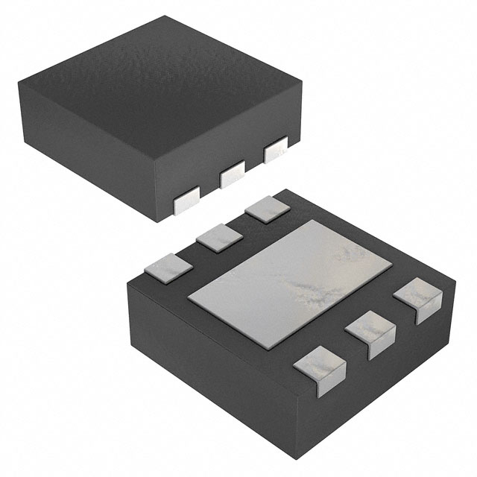
Component selection: Bio-sensors
Temperature: TI TMP117
6 pin, 2.00 mm x 2.00 mm, WSON-6
±0.1°C from -20°C to +50°C
16-bit resolution: 0.0078 °C, I²C
$8.02 [X1], 296-51834-1-ND, LINK
IMU: TI BQ27621-G1
14 pin, 2.5 mm x 3.0 mm, 14-LGA
I²C communication
9-axis, 16-bit resolution
Full operation mode = 925 uA
$4.98 [X1], 828-1057-1-ND, LINK
TMP117
BMI160

Slide 20
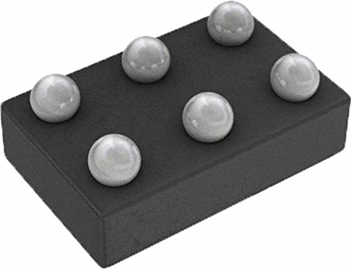
Component selection: Bio-sensors
Pressure & Strain: LMV981
6 pin, 1.5 mm x 1.3 mm, 6-DSPGA
Differential Amplifier, I²C
$1.63 [X2], LMV981, LINK
LMV981

Slide 21
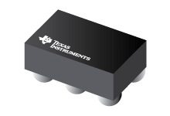
Component selection: wireless charging
Wireless charging IC: TI BQ51003
28 pin, 1.90 mm x 3.00 mm
QI v1.2 communication protocol
93% AC-DC efficiency
$3.00 [X1], 296-39952-1-ND, LINK
LiPo battery charger IC: TI BQ25100
6 pin, 1.6 mm x 0.90 mm, 4.2V 1 cell
1% Charge voltage accuracy
10 mA to 250 mA charging current
$2.24 [X1], 296-38373-1-ND, LINK
BQ51003
BQ25100

Slide 22
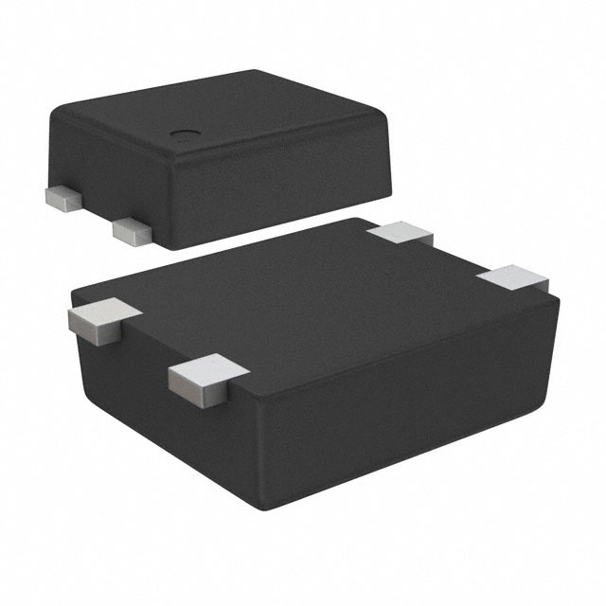
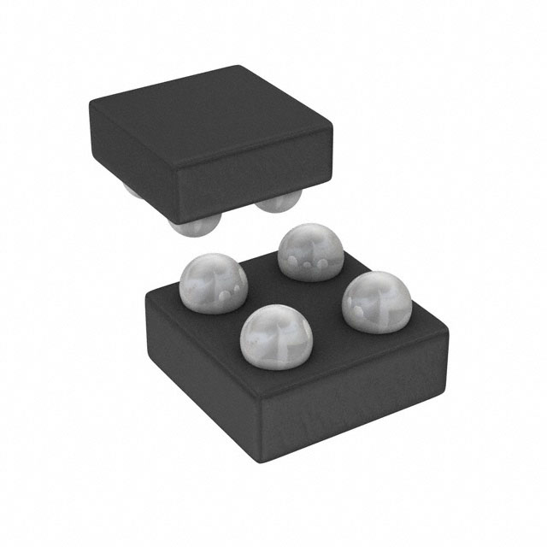
Component selection: power circuit
Reed Switch: ABLIC S-5712A
4 pin, 1.90 mm x 3.00 mm, SNT-4A
Non-contact ‘power switch’
High accuracy hall effect switch IC
$1.07 [X1], 1662-1617-1-ND, LINK
Linear Regulator: Analog Devices ADP172
4 pin, 0.95 mm x 1.03 mm, 4-WLCSP
0.1V dropout voltage
300 mA max current
$1.09 [X1], ADP172ACBZ-3.0-R7CT-ND, LINK
S-5712A
ADP172

Slide 23
Component selection: power circuit
Charging coil: Wurth 760308101219
1 coil, 1 layer, D=15 mm, H=0.6 mm
11.8 uH, 750 mΩ, t = ±10%
$7.43 [X1], 732-9675-ND, LINK
760308101219

